Slide 1
ESL solution introduction
(Connecting your ESL to IOT cloud promptly)

Slide 2
Outline
Introduction
Architecture
ESL and Gateway
Solution Feature
Notes:
antenna

Slide 3





Software/hardware Architecture
Customer Inventory System
ESL/Gateway using MQTT/JSON open API for third part to easy integrate it.
Subscribe
/Publish
MQTT Broker
Our hardware/software system
WiFI
BLE5.0
OpenAPI(MQTT/JSON)
IP network
BLE5.0
Cable Eth
Gateway
ESL
Notes:
antenna

Slide 4
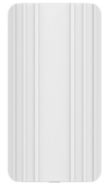
ESL Gateway
Water proof-IP54/Sun proof（ Industry only ）
BLE5.0 Long distance Feature（ Industry only ）
BLE distance: > 200 meters in open space
Self-organized for ESL device
Open protocol: MQTT to cloud
Configuration: Web portal
Transmit: ETH/Wifi/Wifi-hopping
Power: 5V DC and ETH PoE(802.3af)
Base on latest OpenWrt 18.29
BLE chip: TI CC2640R2F
Notes:
antenna

Slide 5
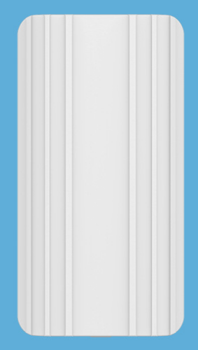
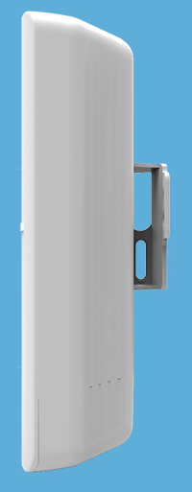
ESL Gateway Specifications
Item | Description
Power | 802.3af PoE DC 5V
Manage ESL number | > 200 ESL
Wireless distance | BLE5.0: > 200 meters BLE4.0/4.1/4.2 > 100 meters (depends on environment)
Transmitting way | ETH RJ45 WiFi WiFi hoppen USB (For 3G/4G dongle)
Transmitting protocol | MQTT
Installation way | Screw
Waterproof/Dustproof | IP54
Size | 173*90*
Material | ABS
Notes:
antenna

Slide 6
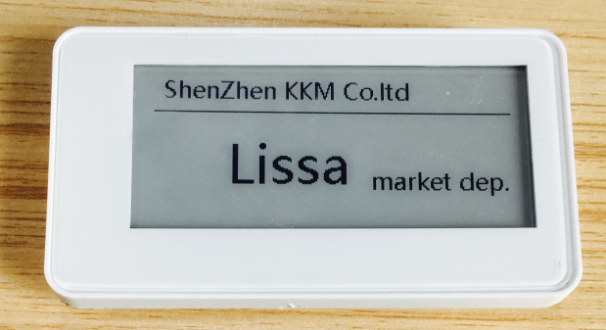
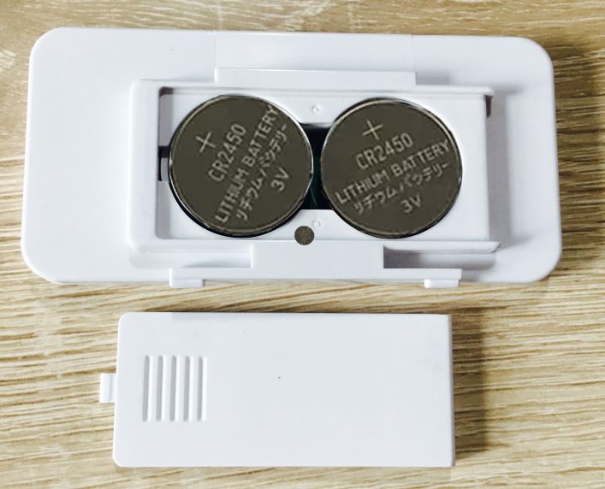
ESL Specifications
Technical Specifications
Item | Description
Power | 2 * CR2450 Battery
Work time | > 4 Years
Battery consumption | Average current < 25uA
Wireless distance | Outdoor around 100 meters Indoor around 30-50 meters (depends on environment)
Transmitting protocol | BLE4.1/BLE5.0
Installation way | 3M or Pylons
Total Size | 93.4*45*11.9mm
Screen Size | 2.9Inch
Material | ABS
Notes:
antenna

Slide 7
Outline
Introduction
Solution Feature
Opening Platform Design
Self-organized deployed
OpenAPI for third part to integration
Security: Two-way authentication
Web portal Configuration UI
Notes:
antenna

Slide 8
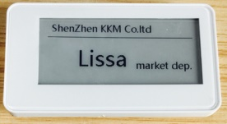
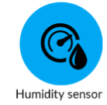
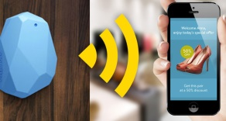
1. Opening Platform Design
ESL Gateway not only an ESL manager. It’s an open platform to make your ESL and other BLE sensor easily connect to cloud.
All the interface are opening for third part.
Support third part ESL/BLE device connect to the cloud via BLE GW;
Support third part MQTT server;
Support your own firmware running on ESL Gateway;
1. Opening authentication algorithm
3. Opening JSON API
(HTTPs/MQTT)
2. Opening downdata/upload data interface
4. Opening source code on Openwrt, you can extend the service/message on BLE GW
iBeacon for navigation/promotion
Notes:
antenna

Slide 9
2. Self-organized deployed
Once you deployed the ESL(>1000pcs) and Gateway, the relationship between ESL and Gateway will automatic setup within 3~5 minute.
Gateway supports redundant configuration, once one Gateway down, other Gateway(with in same coverage) will automatic take over ESL management within 10 seconds.
Gateway support pool load balance deployed, the Customer Inventory System can select an light load Gateway to update price about ESL.
Notes:
antenna

Slide 10
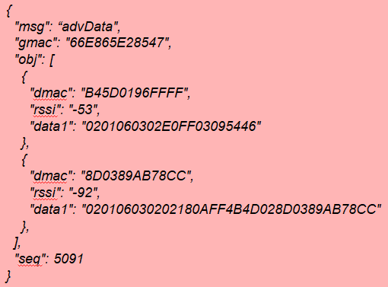
3. Open API Example: ESL monitor
Beacon
BLE GW
HTTPs/MQTT server
Status report
Status report
advData packet example
MQTT/HTTPs
(JSON: advData)
Notes:
antenna

Slide 11
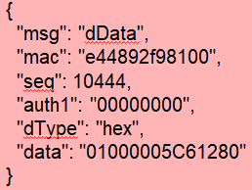
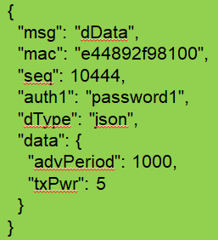
3. Open API Example: ESL update
Download HEX data to beacon
ESL
BLE GW
MQTT Server
MQTT client
1.Publish( downData)
2.Find device and connected to it
3. Update data
modify the ESL status report period to 1000)
4. Ack
5.Publish(Ack)
Support JSON data and hex data type to beacon
Notes:
antenna

Slide 12
3. Open source code/SDK on Github
1. Gateway integration guidance and gateway installation and configuration guidance.
https://github.com/kkmhogen/ESLIntroduction.git
2. The client software Demo supports the connection of the MQTT server address and is based on the Java1.7 version.
https://github.com/kkmhogen/KGatewayClientDemo.git
3. Convert the bmp picture formatted image to the demo of the MQTT JSON message, based on the C language implementation, developed using Visual Studio 2012.
https://github.com/kkmhogen/Bmp2EslJson.git
We will continue to update the resources to make your develop more easily.
Notes:
antenna

Slide 13
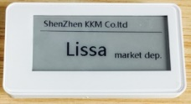
4. Two-way authentication ensures device security
To ensure that the devices and gateways are not illegally connected. BLE Gateway and device using Bi-directional MD5 with random authentication.
1.Verify device valid(MD5)
2. Verify BLE GW valid(MD5)
3. Tx/Rx data
Notes:
antenna

Slide 14
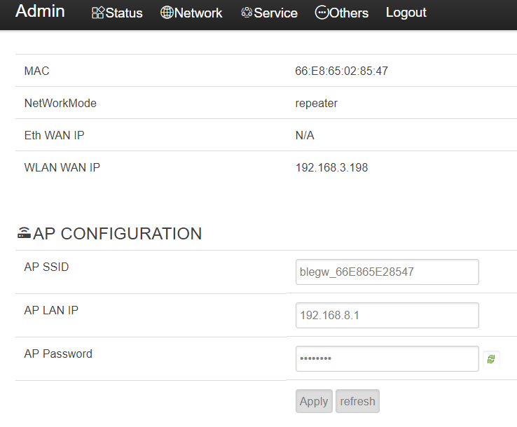
5. Web portal Configuration
The Gateway Support Web portal configuration, for example: chrome explore
No need to install app
Notes:
antenna

Slide 15
Thanks
www.kkmcn.com
Website: www.kkmcn.com
Email: Lissa@kkmcn.com
Address: Room709, Tianhui Building, Qinglin Rd, Longgang District, Shenzhen City, Guangdong Province, China
Tel: 86 755 2837 0901
Mob: 86 137 6045 7755
Notes:
课程名称
华为技术有限公司 版权所有 未经许可不得扩散
x-14

